Slide 1
OS structure
OS services

Slide 2
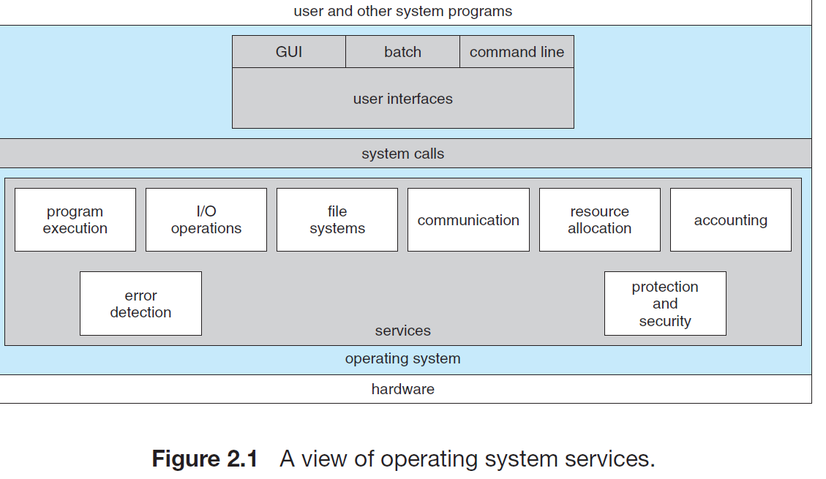

Slide 3
User interface
A user interface (UI) refers to the part of an operating system, program, or device that allows a user to enter and receive information.
A command line interface (CLI) is a text-based user interface (UI) used to view and manage computer files.
Batch interface, in which commands and directives to control those commands are entered into files, and those files are executed.
A graphical user interface (GUI) is a type of user interface through which users interact with electronic devices via visual indicator representations.

Slide 4
Program execution
The system must be able to load a program into memory and to run that program. The program must be able to end its execution, either normally or abnormally (indicating error).

Slide 5
I/O operations
A running program may require I/O, which may involve a file or an I/O device. For specific devices, special functions may be desired For efficiency and protection, users usually cannot control I/O devices directly. Therefore, the operating system must provide a means to do I/O.

Slide 6
File-system manipulation
programs need to read and write files and directories. They also need to create and delete them by name, search for a given file, and list file information. Finally, some operating systems include permissions management to allow or deny access to files or directories based on file ownership. Many operating systems provide a variety of file systems, sometimes to allow personal choice and sometimes to provide specific features or performance characteristics.

Slide 7
Communications
There are many circumstances in which one process needs to exchange information with another process. Such communication may occur between processes that are executing on the same computer or between processes that are executing on different computer systems tied together by a computer network. Communications may be implemented via shared memory, in which two or more processes read and write to a shared section of memory, or message passing, in which packets of information in predefined formats are moved between processes by the operating system

Slide 8
Error detection
The operating system needs to be detecting and correcting errors constantly. Errors may occur in the CPU and memory hardware , in I/O devices and in the user program . For each type of error, the operating system should take the appropriate action to ensure correct and consistent computing. Sometimes, it has no choice but to halt the system. At other times, it might terminate an error-causing process or return an error code to a process for the process to detect and possibly correct.

Slide 9
Resource allocation
When there are multiple users or multiple jobs running at the same time, resources must be allocated to each of them. The operating system manages many different types of resources. Some (such as CPU cycles, main memory, and file storage) may have special allocation code, whereas others (such as I/O devices) may have much more general request and release code.

Slide 10
Accounting
To keep track of which users use how much and what kinds of computer resources. This record keeping may be used for accounting (so that users can be billed) or simply for accumulating usage statistics. Usage statistics may be a valuable tool for researchers who wish to reconfigure the system to improve computing services.

Slide 11
Protection and security
The owners of information stored in a multiuser or networked computer system may want to control use of that information. When several separate processes execute concurrently, it should not be possible for one process to interfere with the others or with the operating system itself.
Protection involves ensuring that all access to system resources is controlled.
Security of the system from outsiders is also important. Such security starts with requiring each user to authenticate himself or herself to the system, usually by means of a password, to gain access to system resources.

